Slide 1
Software Analysis and Design (CS:3004)
Domain Models
Course Instructor: Nida Munawar
Email Address: nida.munawar@nu.edu.pk
Reference Book: Applying UML and Patterns (An introduction to Object-Oriented Analysis and Design And Iterative Development)
BY Craig Larman
Third Edition

Slide 2
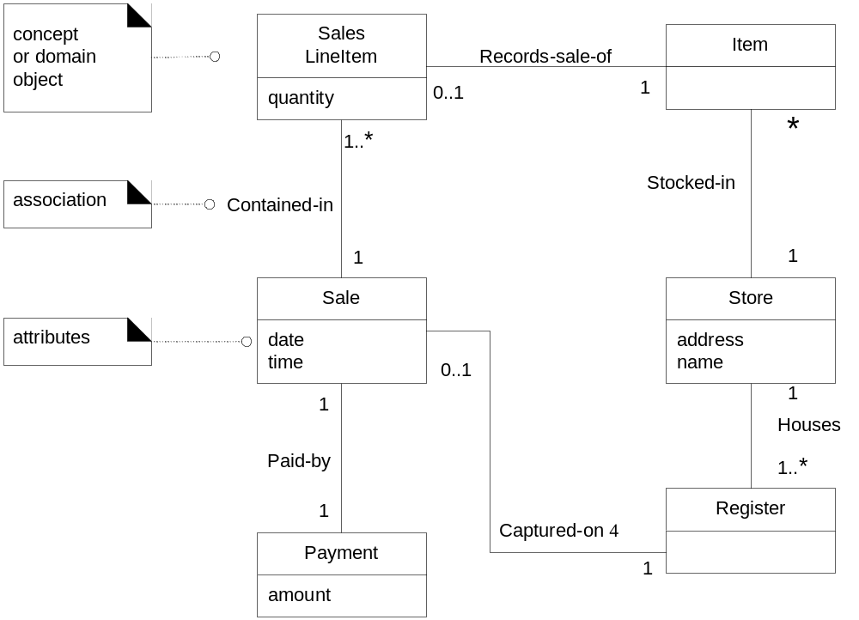
Domain Model in UML Class Diagram Notation
A “visual dictionary”

Slide 3
What is a Domain Model
A domain model is a visual representation of conceptual classes or real-situation objects in a domain [MO95,
Fowler96].
Domain models have also been called conceptual models , domain object models, and analysis object models.[2]

Slide 4
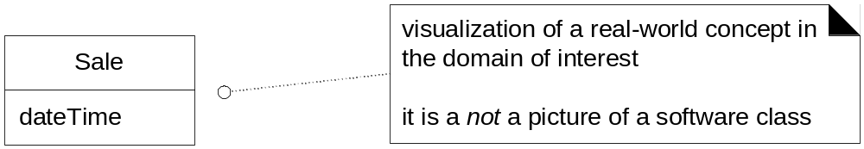
Fig. 9.3

Slide 5
Domain Models
Key object-oriented analysis step: Decompose domain into noteworthy concepts or objects
UML class diagrams used to draw domain models
  Conceptual perspective. Shows:
    Domain objects (conceptual classes)
    Associations between domain objects
    Attributes of conceptual classes
Domain model is NOT a model of software objects or our design
The following should NOT be in a domain model
  Software artifacts: Window, database, …
  Responsibilities or methods

Slide 6
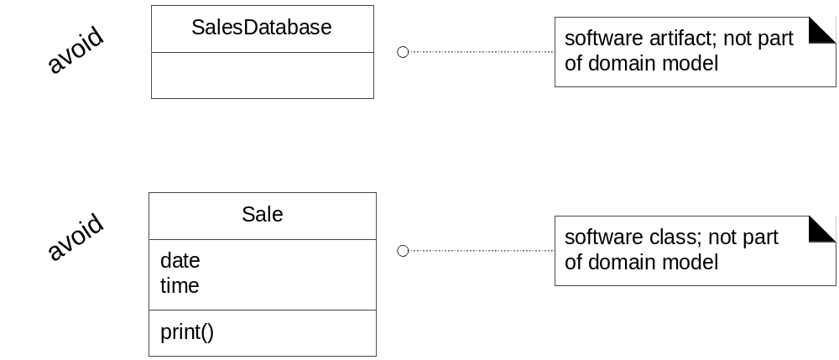
Fig. 9.4

Slide 7
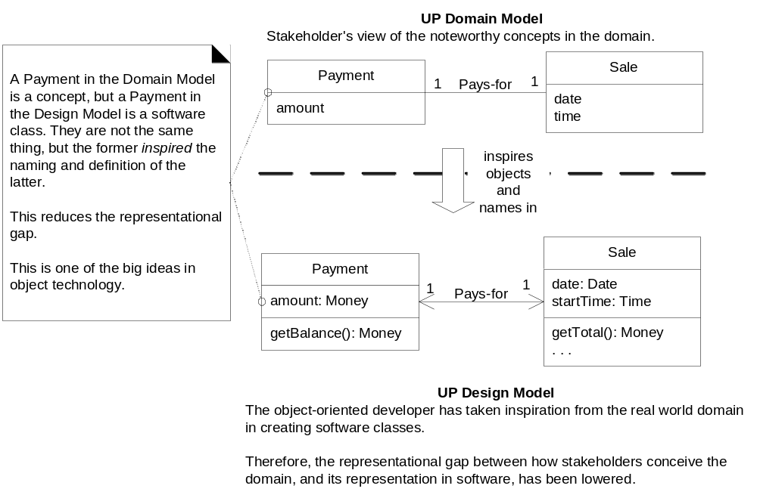
Software Class Names Inspired by Domain Model Objects

Slide 8
Definition: What are Conceptual Classes?
The domain model illustrates conceptual classes or vocabulary in the domain. Informally, a conceptual class is
an idea, thing, or object. More formally, a conceptual class may be considered in terms of its symbol, intension, and extension
Symbol words or images representing a conceptual class.
Intension the definition of a conceptual class.
Extension the set of examples to which the conceptual class applies.

Slide 9
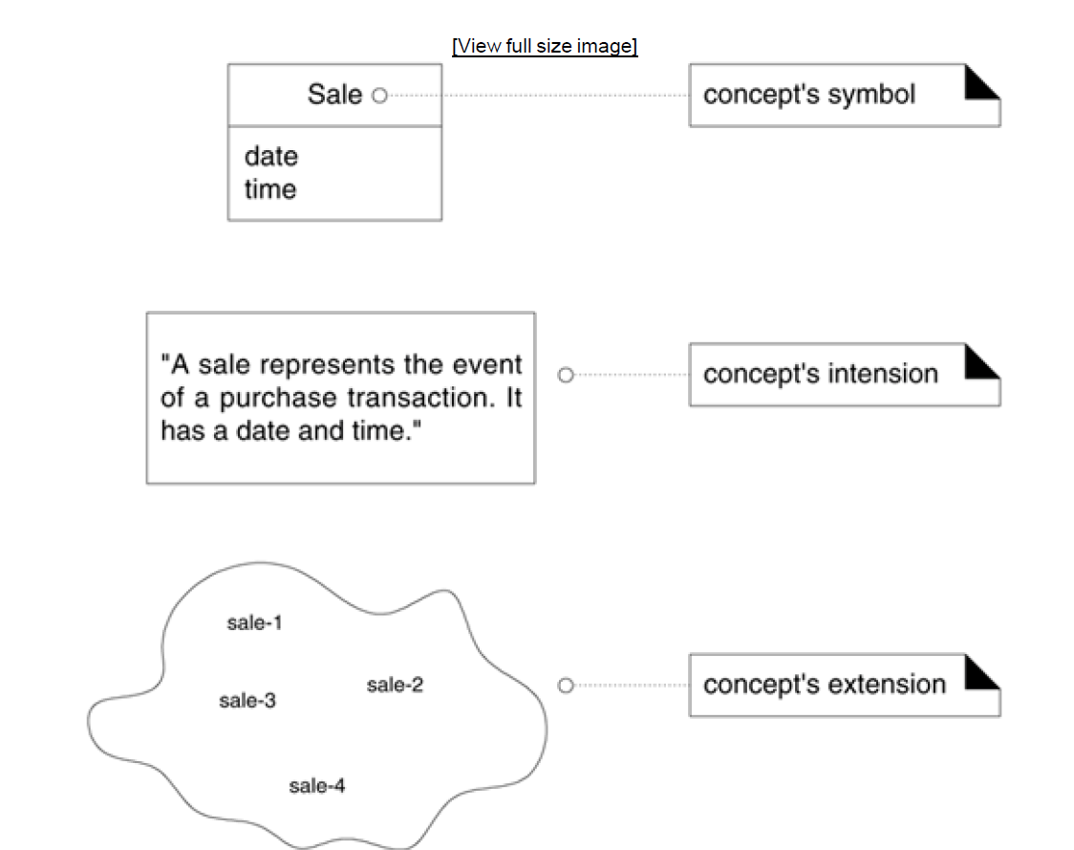
Figure 9.5. A conceptual class has a symbol, intension, and extensio

Slide 10
9.3. Motivation: Why Create a Domain Model?
I'll share a story that I've experienced many times in OO consulting and coaching. In the early 1990s I was
working with a group developing a funeral services business system in Smalltalk, in Vancouver (you should see
the domain model!). Now, I knew almost nothing about this business, so one reason to create a domain model
was so that I could start to understand their key concepts and vocabulary.
We also wanted to create a domain layer of Smalltalk objects representing business objects and logic. So, we
spent perhaps one hour sketching a UML-ish (actually OMT-ish, whose notation inspired UML) domain model,
not worrying about software, but simply identifying the key terms. Then, those terms we sketched in the
domain model, such as Service (like flowers in the funeral room, or playing "You Can't Always Get What You
Want"), were also used as the names of key software classes in our domain layer implemented in Smalltalk.

Slide 11
How to create a domain model?
Find conceptual classes
  How?
    Method 1:Re-use or modify existing models(good but outside our scope)
    Method 2:Use a category list
    Method 3:Identify noun phrases
    More on these later
Draw them as classes in a UML class diagram
Add associations and attributes
  More on this later

Slide 12
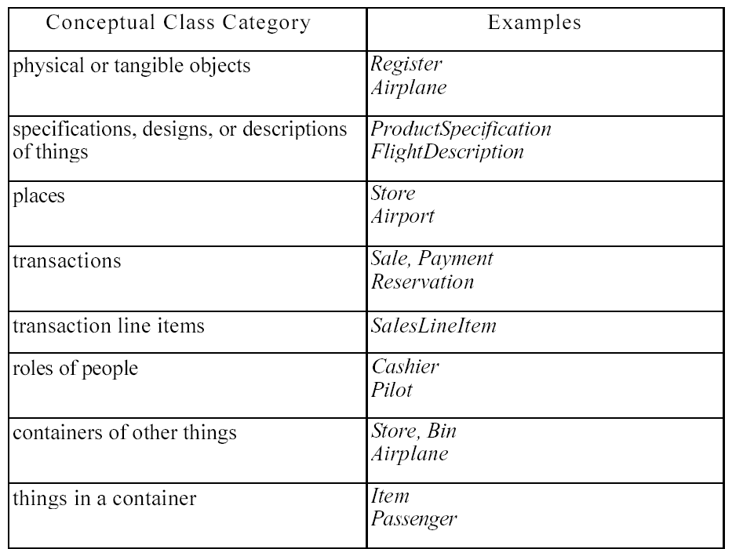

Slide 13
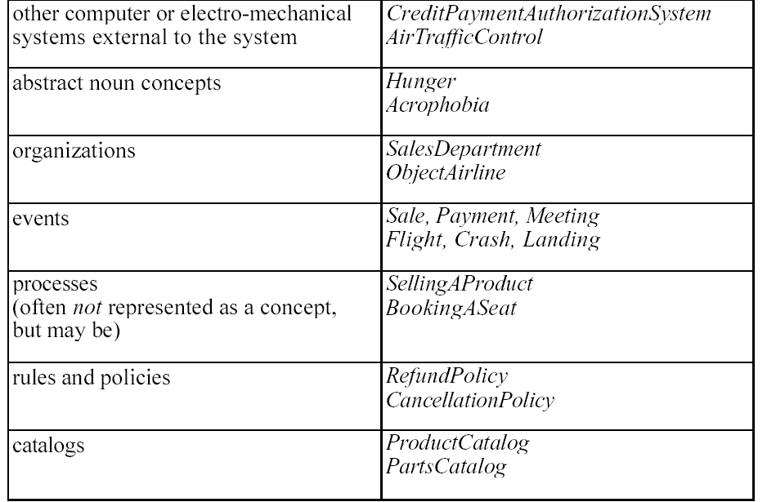

Slide 14
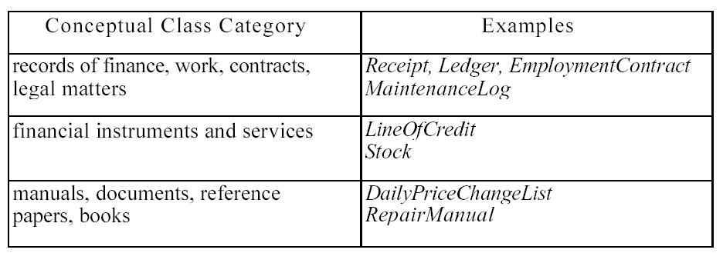

Slide 15
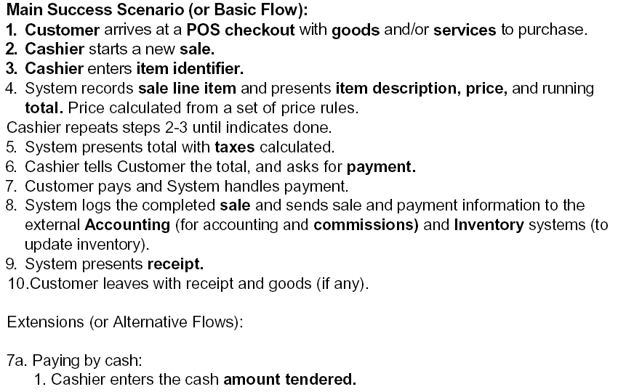

Identifying nouns as candidates for domain objects

Slide 16
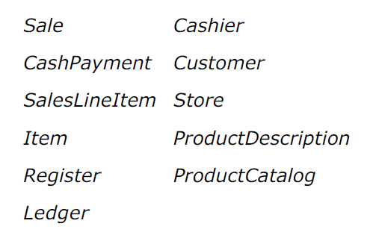

Slide 17
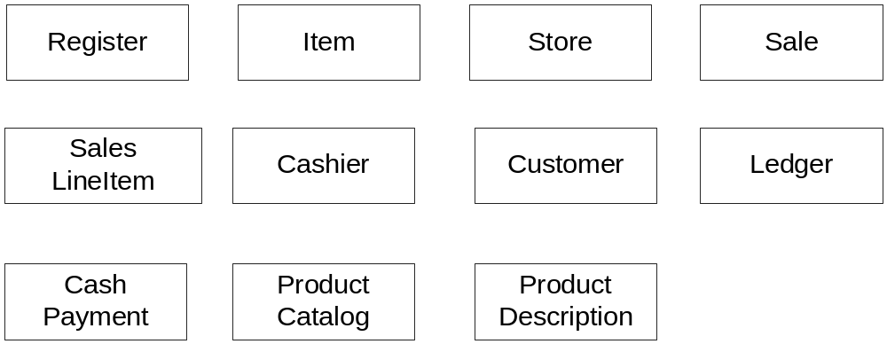
Candidate Conceptual Classes: Process Sale, Iteration 1

Slide 18
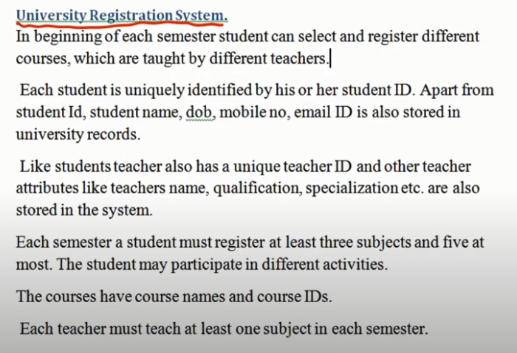
Activity: identify the nouns

Slide 19
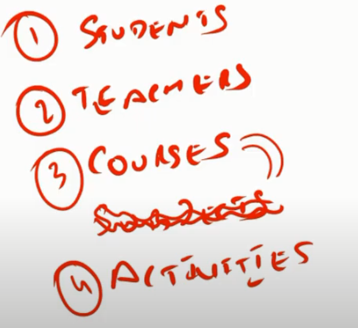
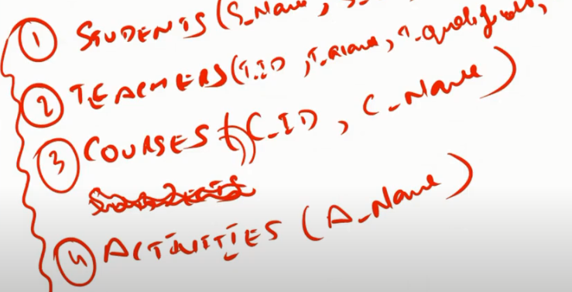

Slide 20
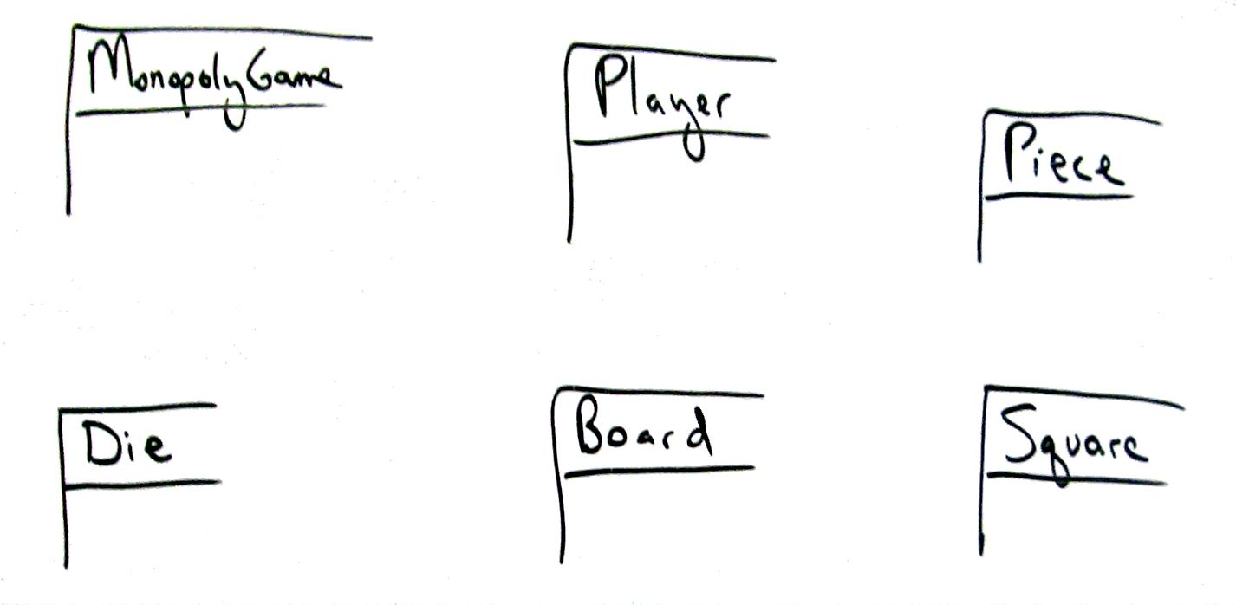
Case Study: Monopoly Domain

Slide 21
A Common Mistake with Attributes vs. Classes
Should “something” be
  an attribute of a class? or
  a separate conceptual class?
Guideline
If we do not think of some conceptual class X as a number or text in the real world, X is probably a conceptual class, not an attribute.

Slide 22
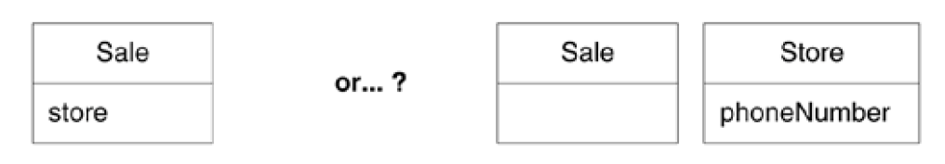
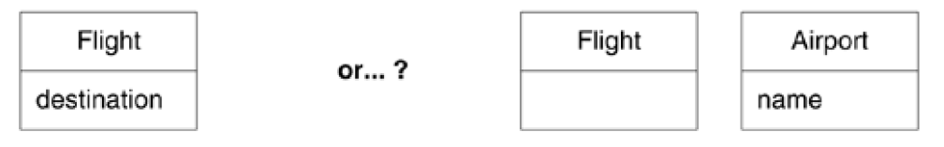
example
  Store: An attribute of Sale or separate class
  Flight destination: An attribute or a separate class

Slide 23
A Common Mistake with Attributes vs. Classes
Examples:
  Store: An attribute of Sale or separate class
    Store: Not a number or text
    Should be separate conceptual class
  Flight destination: An attribute or a separate class
    Destination is an airport, not a number
    Should be separate conceptual class
Guideline:
  If we thing of something as simply a number or text in real life, it should be an attribute.
  Otherwise it should be a conceptual class.

Slide 24
“Description” Classes
A description class contains information that describes something else
  Example: ProductDescription
  Records price, picture and text description of an item
Why use them? Why not include all that information in the Product class?
  We need this information stored and represented even though there are no objects of that particular product type.
  Don’t want to duplicate product information for each duplicate product object
    Serial number belongs with product object
    Picture of product belongs with product description
Need objects that are “specifications” or “descriptions” of other objects

Slide 25
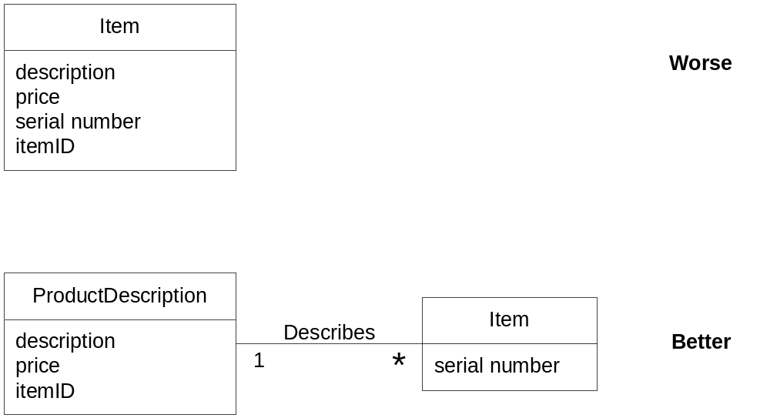
Description class example

Slide 26
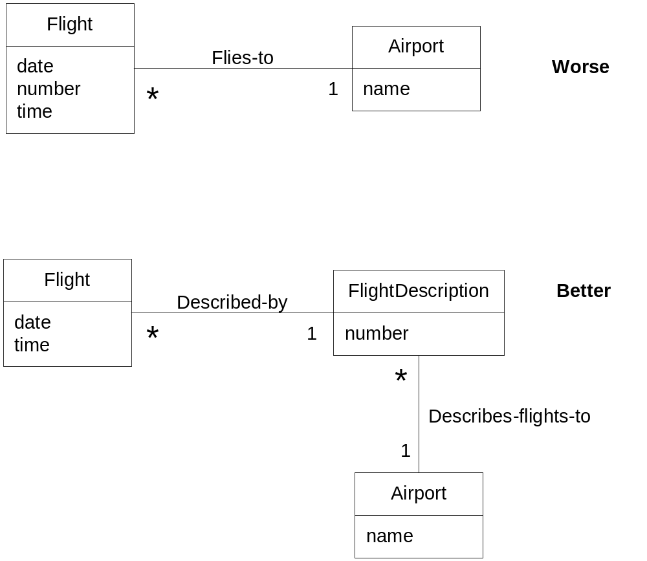
Description class example
Even when that flight is not
scheduled that day, the flight description exists.

Slide 27
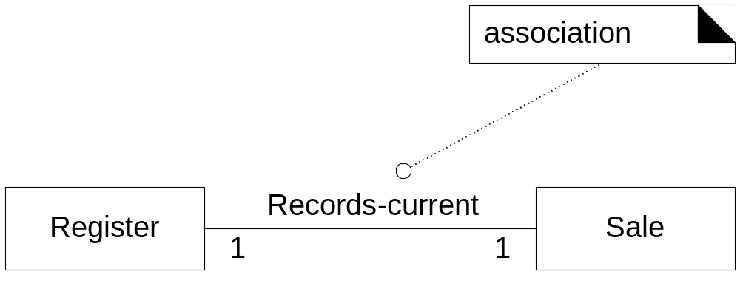
Associations
Association: A relationship between (instances of) classes that indicates some meaningful and interesting connection.
Used to show relationships that need to be remembered and preserved for some duration

Slide 28
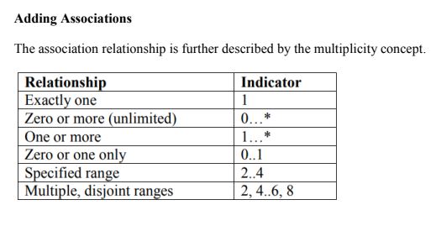
Association
Association is a relationship between two objects. In other words, association defines the multiplicity between objects.

Slide 29
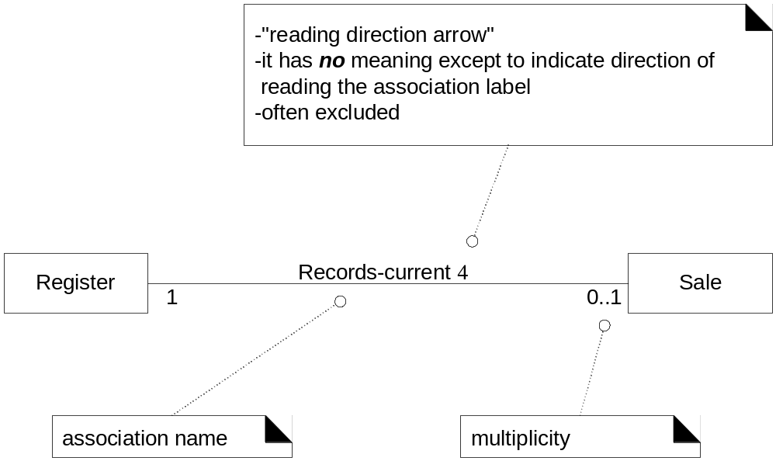
Association Directionalities

Slide 30
How to name an association?
Pattern:
  Class name – verb phrase – class name
  Readable and meaningful
Try to avoid “has” or “uses”. These give no extra information

Slide 31
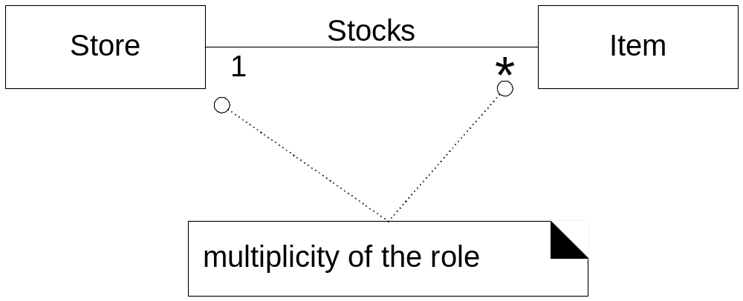
Association Multiplicities

Slide 32
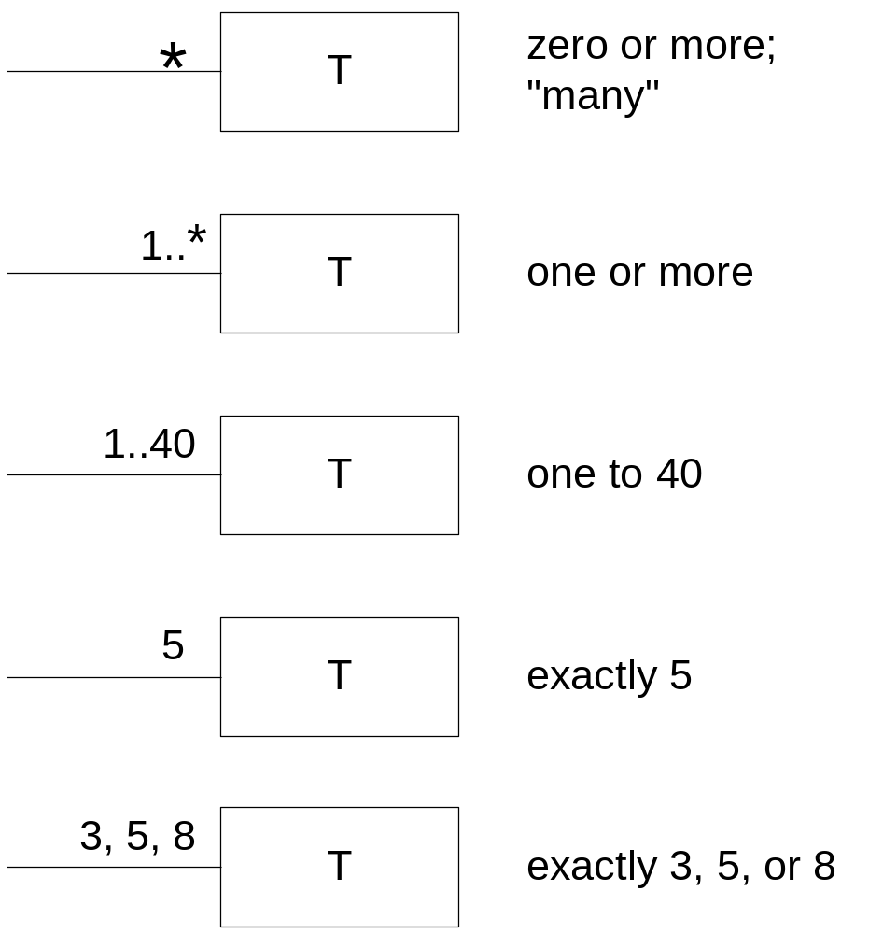
Multiplicities

Slide 33
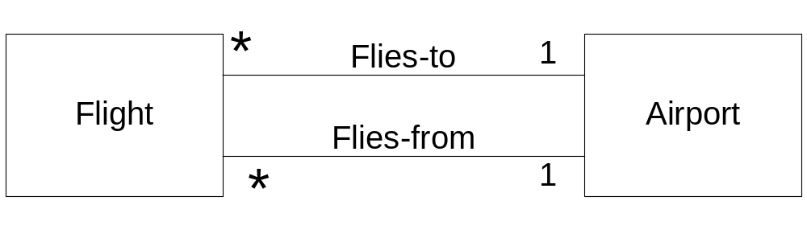
Multiple Associations

Slide 34

Scenario For Practice …

Slide 35
Automated Teller Machine (ATM) is a banking system. This banking system allows customers or users to have access to financial transactions. These transactions can be done in public space without any need for a clerk, cashier, or bank teller. The user is authenticated when enters the plastic ATM card in a Bank ATM, Then enters the user name and PIN (Personal Identification Number). For every ATM transaction, a Customer Authentication is required and essential. User checks the bank balance as well as also demands the mini statement about the bank balance if they want. Then the user withdraws the money as per their need. If they want to deposit some money, they can do it. After complete action, the user closes the session. If there is any error or repair needed in Bank ATM, it is done by an ATM technician. ATM technician is responsible for the maintenance of the Bank ATM, upgrades for hardware, firmware or software, and on-site diagnosis.

Slide 36
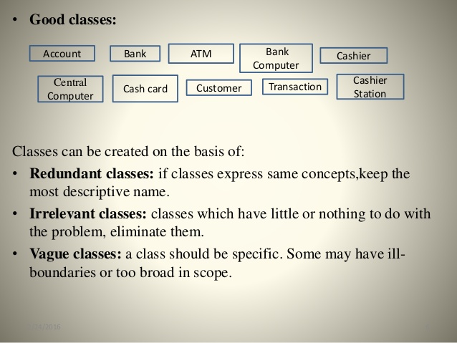
Something more on classes….

Slide 37
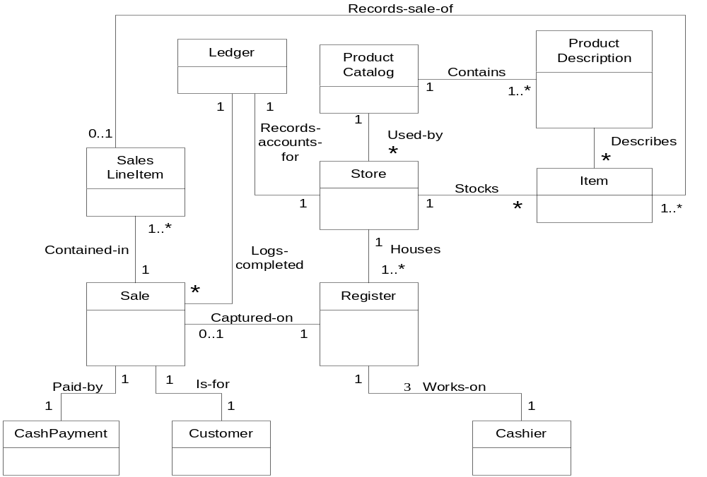
POS Domain Model Example:

